Slide 1
G
-
Fraud Detection

Slide 2
Group Members
D1161 - Samet
D1366 - Necip
D1404 - Selin
D1649 - Fatih
Group Mentor
Mary

Slide 3
Contents
01
Data Cleaning & EDA
02
Data Preprocessing
03
Model Building
04
Model Deployment

Slide 4

Tools
COLAB
STREAMLIT
PYTHON
API
Scrapy
Selenium

Slide 5
Fraud Detection
Welcome to "Fraud Detection Project". This is the last project of the Capstone Series.
One of the challenges in this project is the absence of domain knowledge. So without knowing what the column names are, we will only be interested in their values. The other one is the class frequencies of the target variable are quite imbalanced.
We will implement Logistic Regression, Random Forest, Neural Network algorithms and SMOTE technique. Also visualize performances of the models using Seaborn, Matplotlib and Yellowbrick in a variety of ways.
At the end of the project, we will have the opportunity to deploy our model by Streamlit API.

Slide 6
Employee Churn Analysis
General Information
The dataset contains transactions made by credit cards in September 2013 by European cardholders.
This dataset presents transactions that occurred in two days, where we have 492 frauds out of 284,807 transactions. The dataset is highly unbalanced, the positive class (frauds) account for 0.172% of all transactions.
It contains only numerical input variables which are the result of a PCA transformation. Unfortunately, due to confidentiality issues, the original features and more background information were not supplied about the data.
Feature Information:
Time: This feature is contains the seconds elapsed between each transaction and the first transaction in the dataset.
Amount: This feature is the transaction Amount, can be used for example-dependant cost-senstive learning.
Class: This feature is the target variable and it takes value 1 in case of fraud and 0 otherwise.

Slide 7
STEPS
Step 3
Step 5
Step 1
Model Building
Final Presentation
Data Cleaning & Exploratory Data Analysis
Step 2
Step 4
Data Preprocessing
Model Deployment

Slide 8
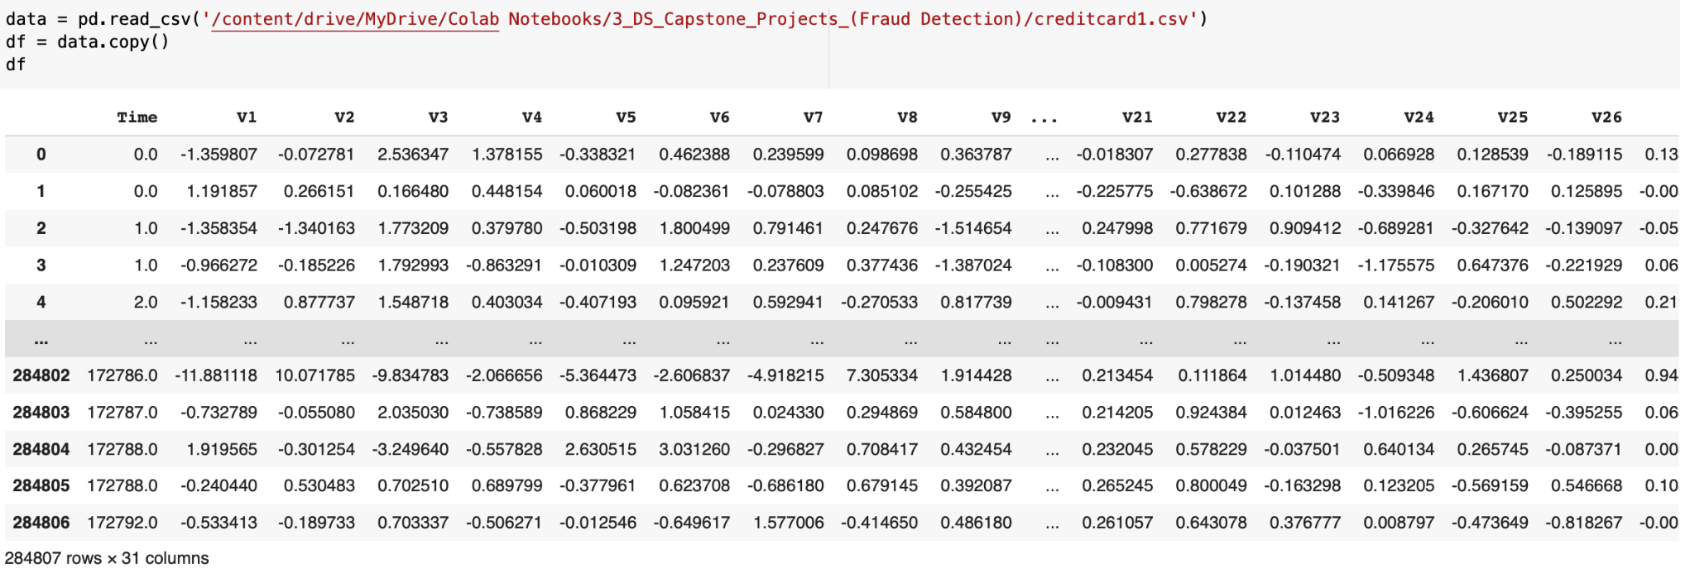
Quick Look at Our Dataset
STEP 1

Slide 9
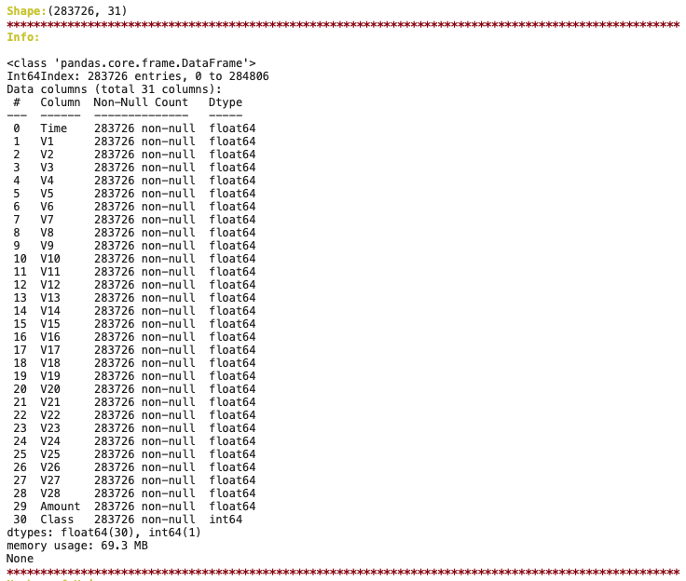
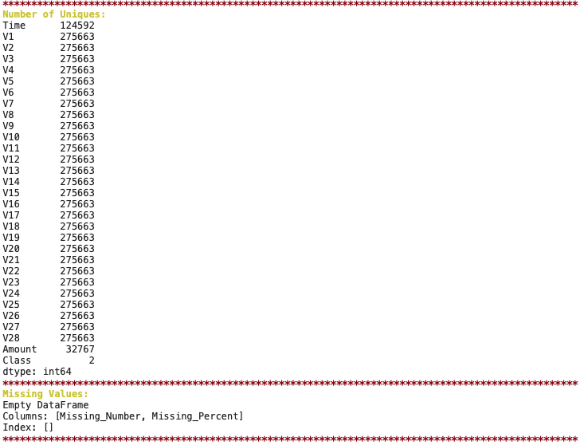
STEP 1

Slide 10
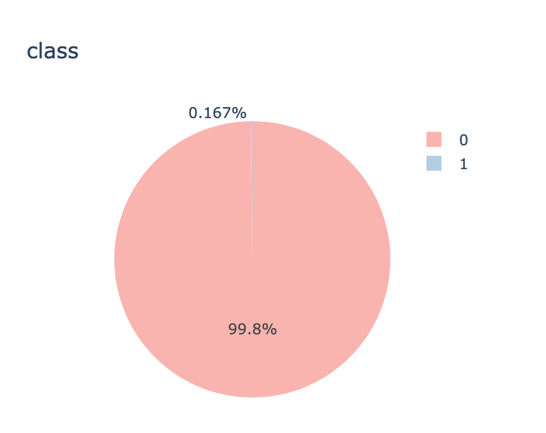
Comparing Fraud and No Fraud
STEP 1

Slide 11
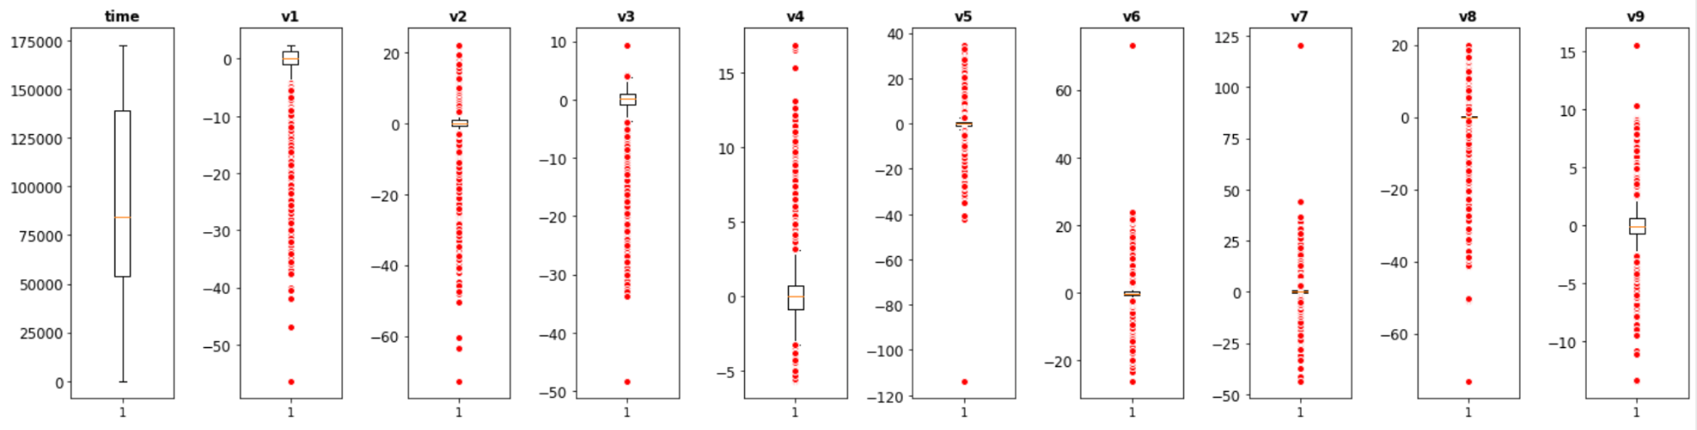
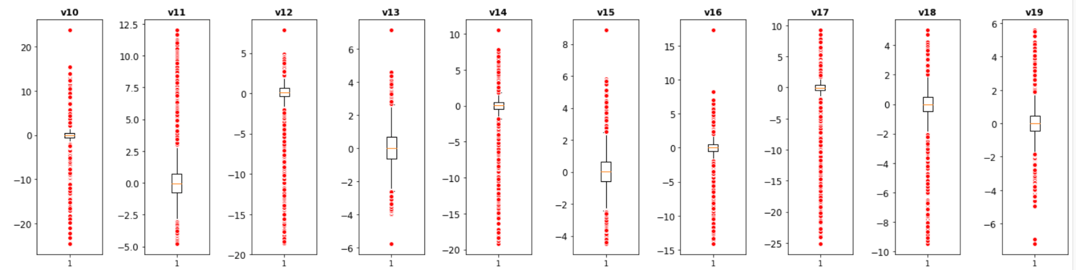
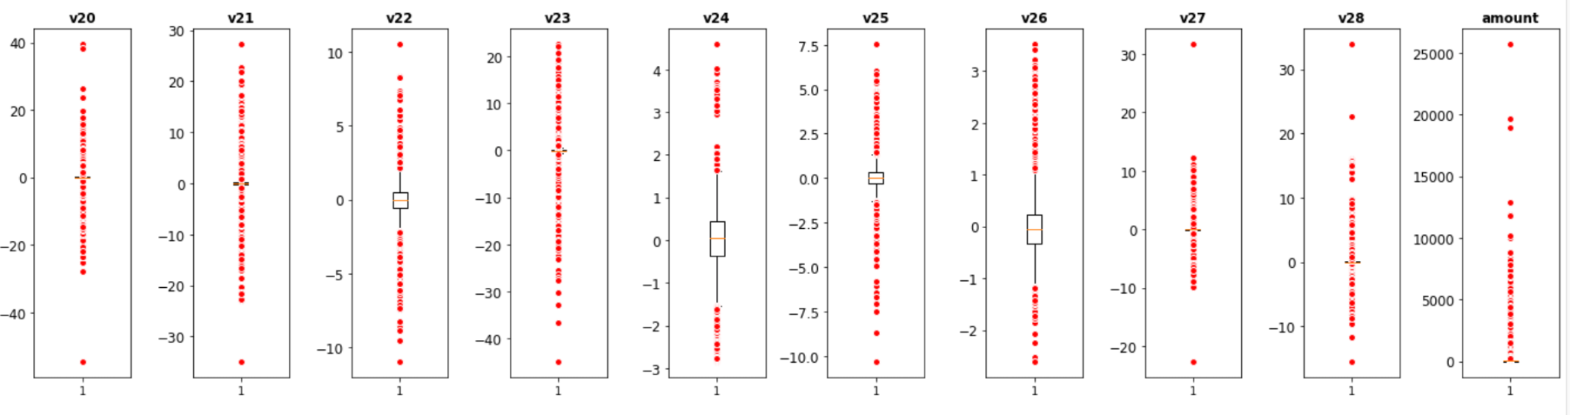
We take a quick look at the distribution of our features to get a general idea

Slide 12
OUTLIERS
We basically have two strategies for Outliers.
Strategy 1: We look at each feature one by one and manually delete over or under a certain value.
Result of Strategy 1:
In strategy 1 totally 20 row was dropped
Strategy 2: This is a slightly more complex point of view than our first strategy. Because with the function we created, we delete outliers to certain groups, but we only delete outliers that are 0, not 1 that are already less. We have two main reasons for this. First of all, Fraud class is very less and we can't lose our data, which is Fraud. Second, Fraud rate is high in outliers. If we leave Fraud alone in outliers the results of model can be better than the first case.
Results of Strategy 2:
17056 outlier values were dropped. All of them are class 0 outliers.
It is seemed among the outliers the ratio of class 1 is higher than its ratio in all data.
This means that most of frauds are outlier movements.
The model probably gives better results when we drop only class 0 outliers but it can cause bad results if the model we created is tested on other data. Let's try and see.
STEP 1

Slide 13
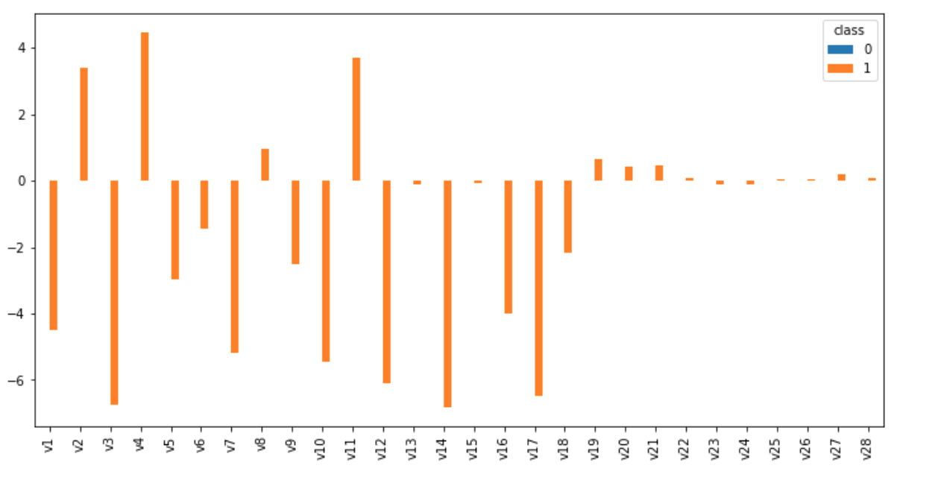
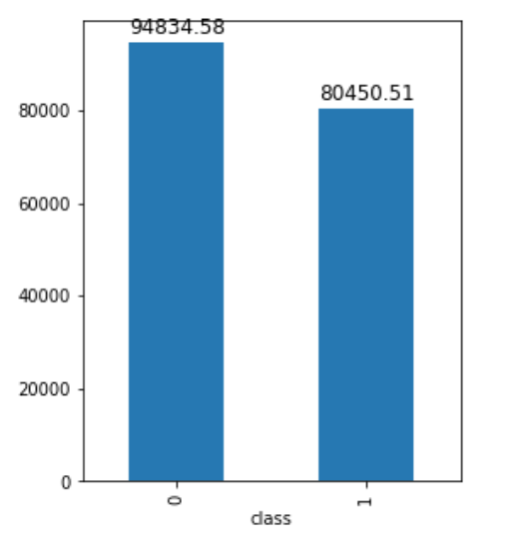
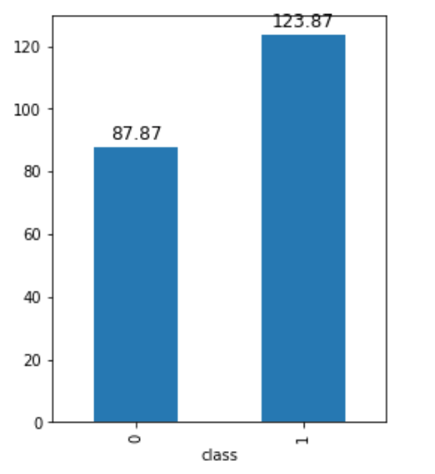
Grouping by Class (Mean)
Grouping by Time (Mean)
Grouping by Amount (Mean)
STEP 1

Slide 14
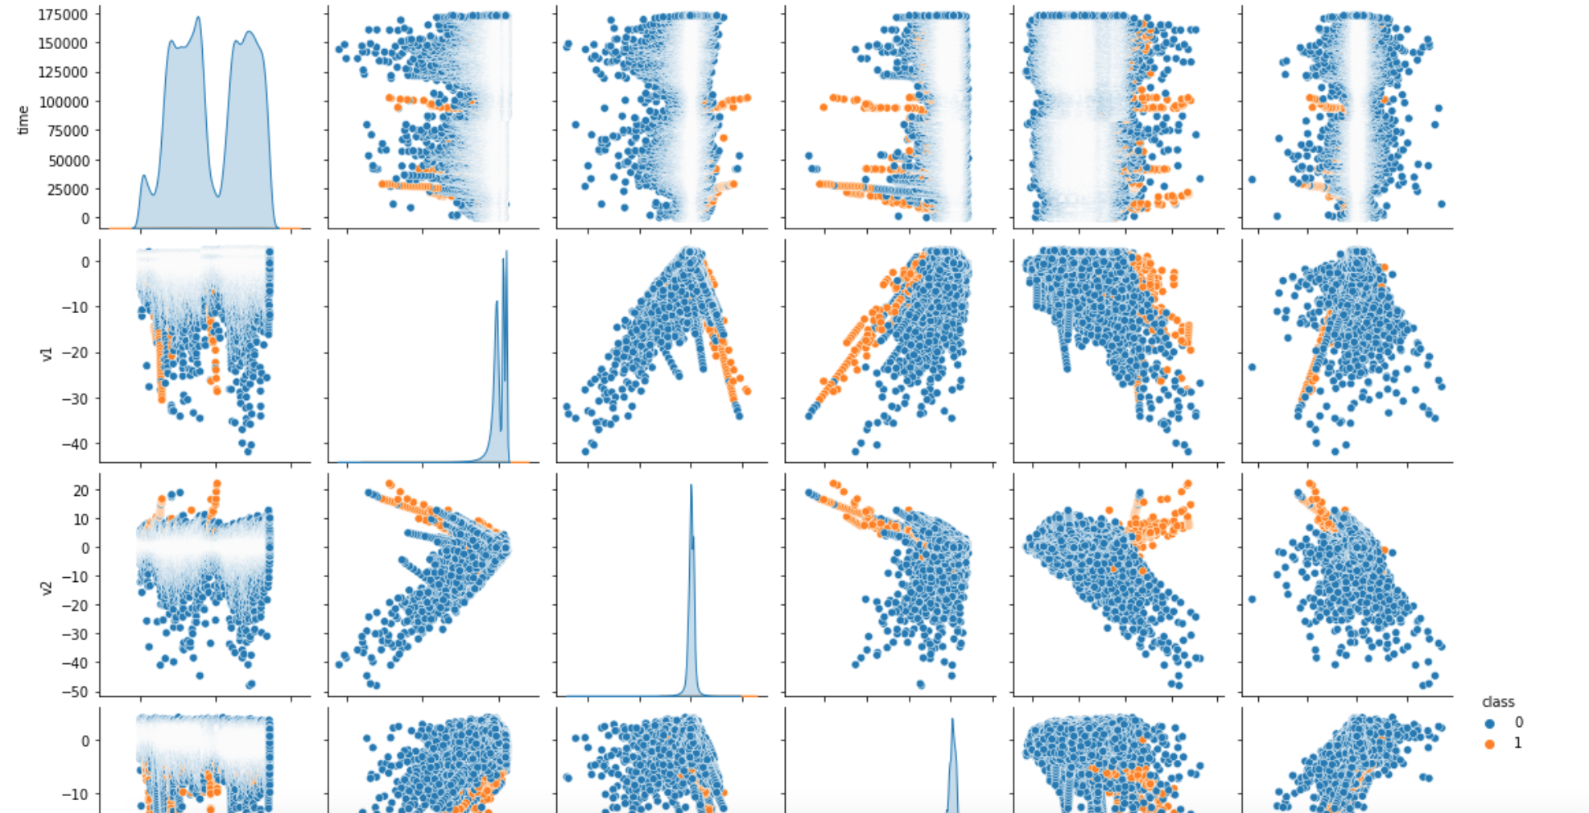
Since data is very big, only pairplots of some columns were given. In the scatter plots, it is seen that frauds are mostly in the outliers
STEP 1

Slide 15
SMOTE
We basically have two strategies for SMOTE.
Strategy 1: We applied Smote to all data
Result of Strategy 1:
We got better scores.
Strategy 2: During our research, we encountered approaches that found the application of Smote to the train dataset more accurate. We also experimented with different points of view. Therefore we applied Smote only train dataset.
Results of Strategy 2:
Our test scores were much lower, as we applied Smote to all data. Therefore, our doubts about the application of Smote have increased.
STEP 3

Slide 16
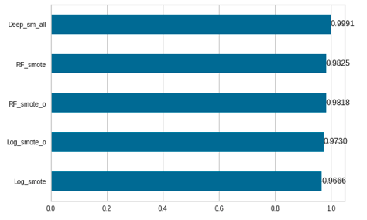
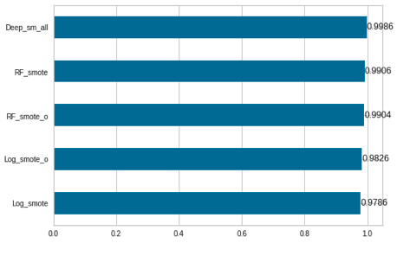
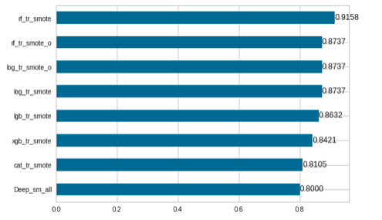
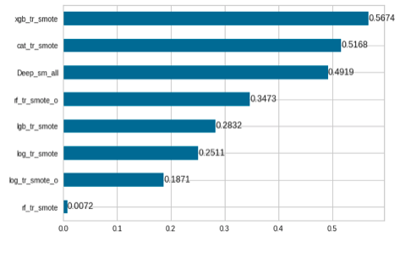
SMOTE applied to all data (Recall)
SMOTE applied to all data (F1)
SMOTE applied to only train (Recall)
SMOTE applied to only train (F1)
STEP 3

Slide 17
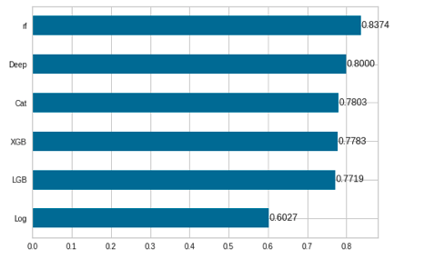
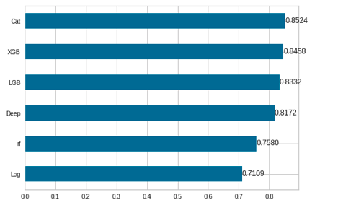
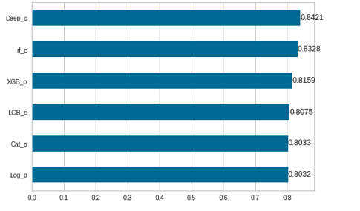
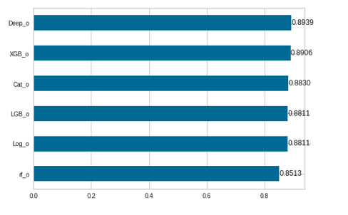
Dropped only extreme outliers (Recall)
Dropped only extreme outliers (F1)
Dropped more outliers (Recall)
Dropped more outliers (F1)
STEP 3

Slide 18
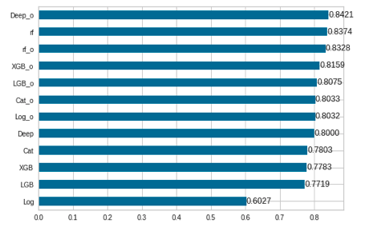
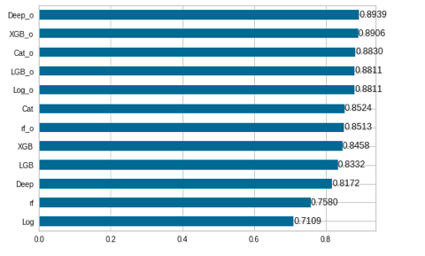
Scores without SMOTE (Recall)
Scores without SMOTE (F1)
STEP 3

Slide 19
Conclusion
Evaluation based on the recall and F1 scores.
There is a tradeoff between precison and recall in fraud analysis. There is a cost of fraud. But also there is a cost of false frauds (positives). (the cost of human labour for investigating the flagged transactions) In the article, "https://www.kaggle.com/code/robinteuwens/precision-vs-recall-optimizing-fraud-costs/notebook" it is said that "reducing the false negative rate (catching a fraud transaction) is 70 times as important as reducing the false positive rate." So according to this article recall is more important.
Models applied to smote data (smote both applied to train and test) gave the best results. Recall, Precision and F1 scores of these models were almost 1.
But these model are not seem very reliable. Because the scores of the models applied to smote data (only train data) was not good. Especially, precison scores of these models were very low. In many article, it is expressed that smote should be applied to only train data to avoid data leakage.
For these reasons machine and deep learning models were applied directly to dataframes that we created.
The models applied to the dataframe which was dropped more outliers (17056), gave better results that the dataframe which was dropped only extreme outliers (20). This was an expected result, as the rate of frauds is higher in outliers. However, if this is considered as directing the model, the results of the model may not be good on other data. But in any case, the recall result is expected to be good.
Scores of smote models are very high and close to each other. Best of them is deep learning model.
The best scores also is deep learning model in without smote datas. But also scores of XGB and Catboost is good.
STEP 3

Slide 20
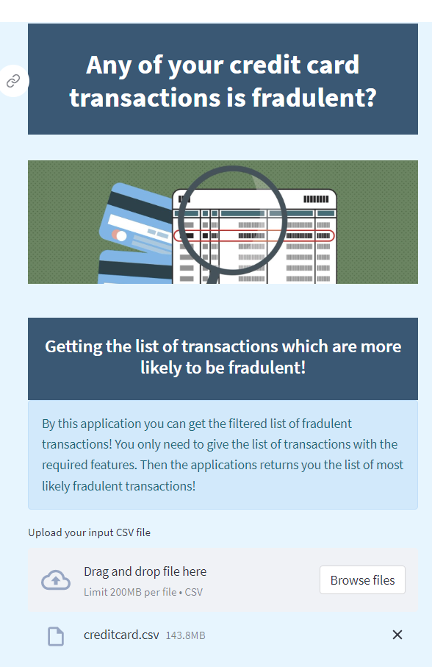
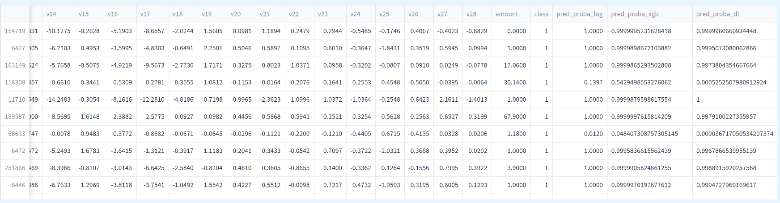
MODEL DEPLOYMENT
https://arifatih-fraud-detection-app-mikqbu.streamlitapp.com/
STEP 4

Slide 21
NOTEBOOK

Slide 22
FEEDBACKS

Slide 23
THANK YOU

